Slide 1
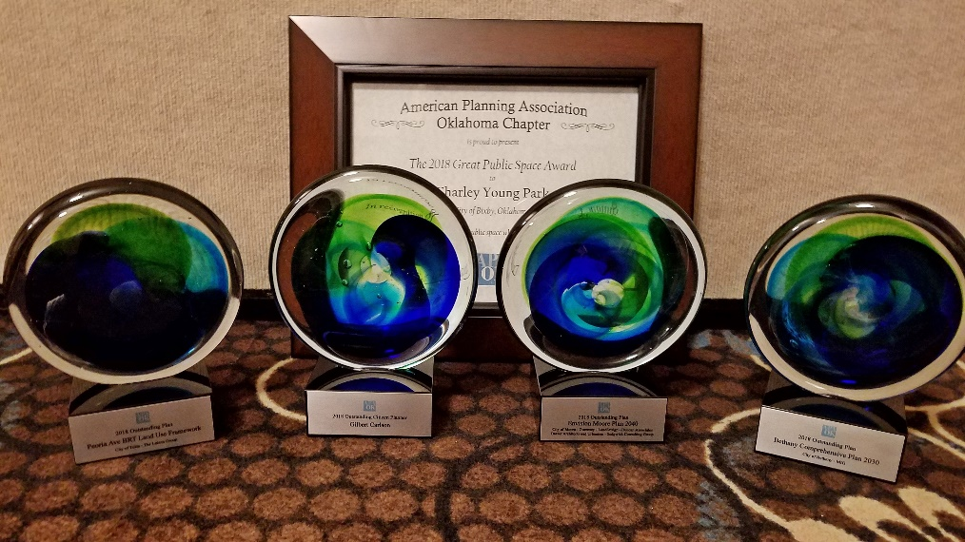
2023 OKLAHOMA CHAPTER AWARDS
American Planning Association

Slide 2
AWARD CATEGORIES
Outstanding Public Outreach, Program, Project, Tool, Community Initiative
Great Neighborhood, Street or Public Space
Outstanding Plan
Outstanding Citizen Planner
Outstanding Student Project

Slide 3
AWARD CATEGORIES
Outstanding Plan
Outstanding Citizen Planner
Outstanding Student Project

Slide 4
AWARD CATEGORIES
Outstanding Plan
Outstanding Citizen Planner
Outstanding Student Project

Slide 5
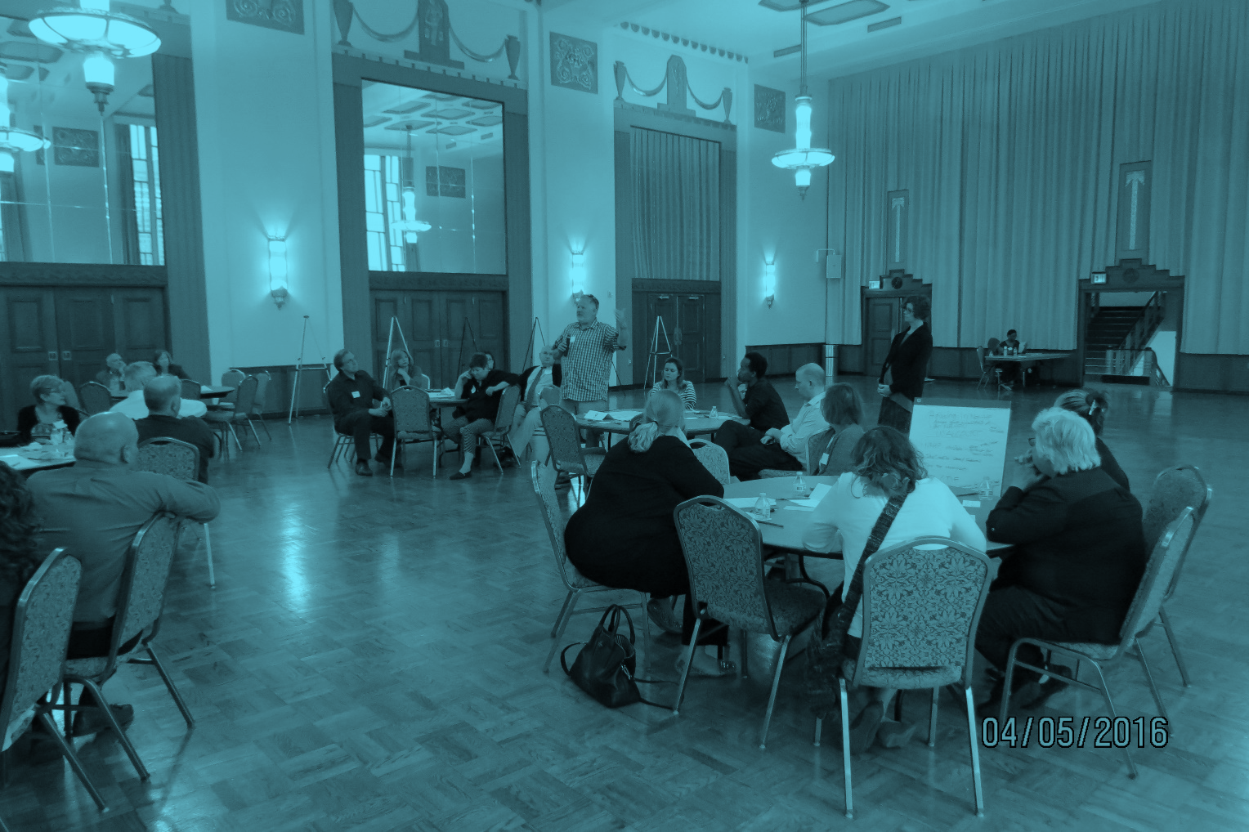
APA-OK’S OUTSTANDING PLAN
2023 PRESERVEOKC
City of Oklahoma City
Notes:
Oklahoma City’s first historic preservation plan. Prepared entirely in house by City of Oklahoma City Planning Department staff, preserveokc is innovative in its approach to the incorporation of historic preservation into broader planning practices and principles. It emphasizes the important role that the revitalization, rehabilitation, and adaptive reuse of existing buildings and districts have in the growth and development of Oklahoma City.

Slide 6
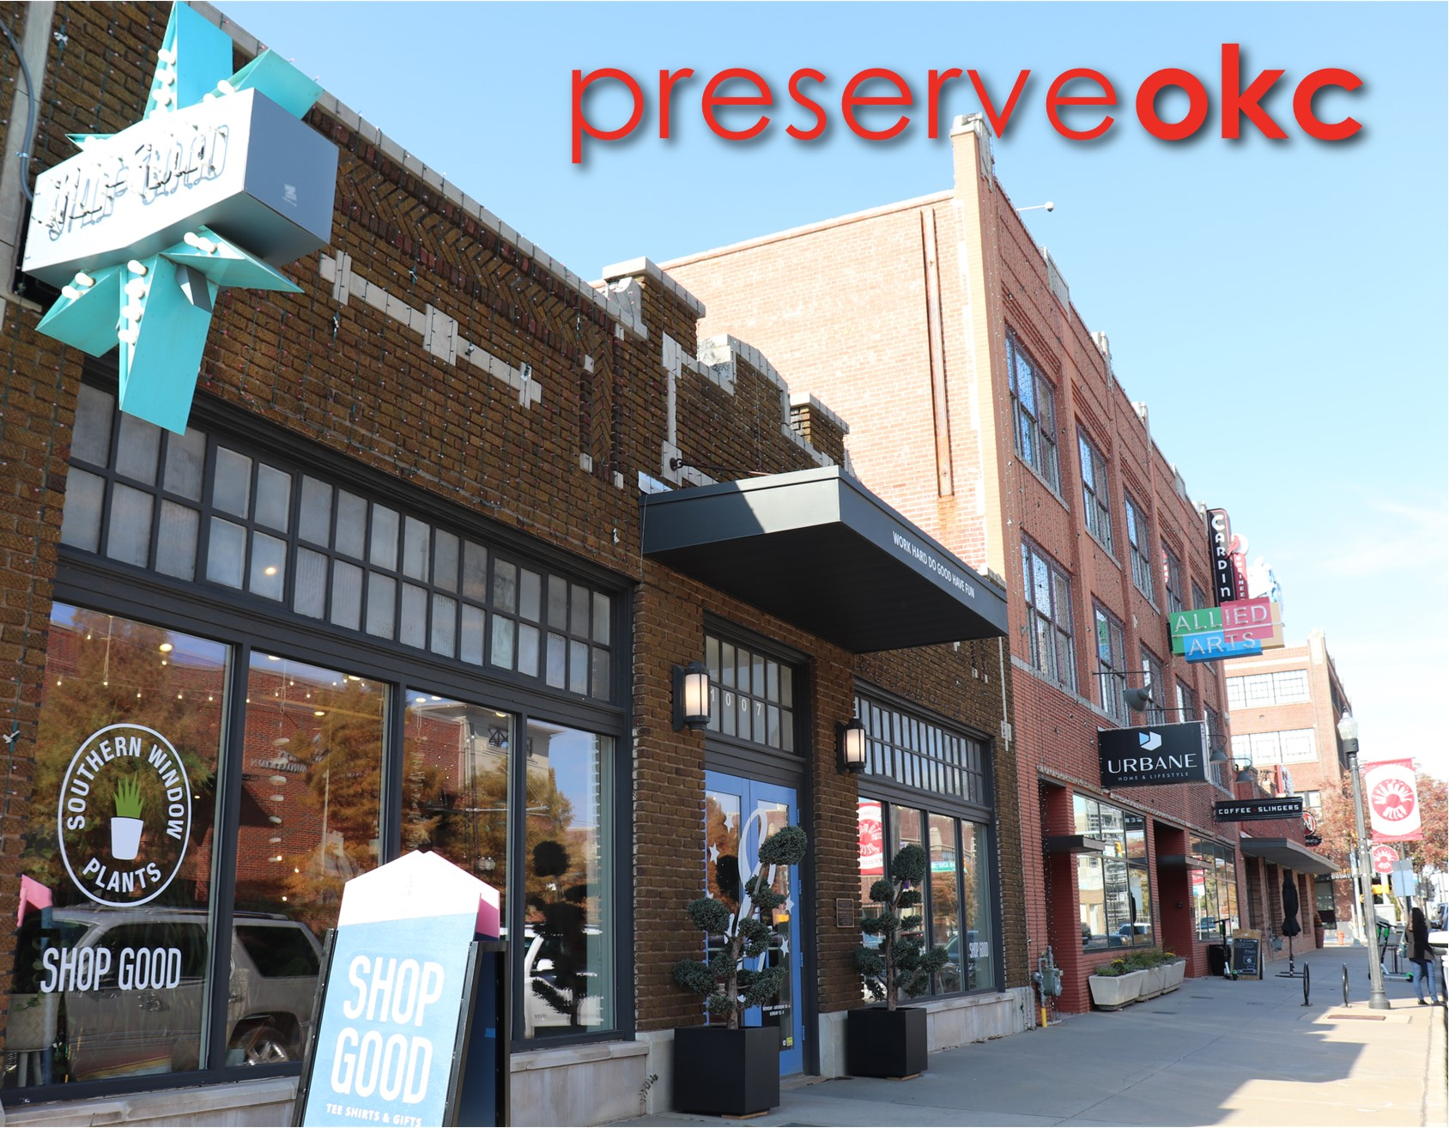
APA-OK’S OUTSTANDING PLAN 2023 PRESERVEOKC
Cover illustration on final plan
Notes:
In July 2015, the City of Oklahoma City adopted a new comprehensive plan, planokc. The policies adopted in planokc include the City’s approach to heritage, culture, urban design, and historic preservation, most notably within the enrichokc element of the plan. This element’s first initiative is to develop and implement a historic preservation plan.

Slide 7
APA-OK’S OUTSTANDING PLAN 2023 PRESERVEOKC
Age of Structure Map
Notes:
Preserveokc builds on the priorities identified in planokc to comprehensively address the identification, retention, and preservation and revitalization of the city’s cultural, historic, architectural, and archeological resources.

Slide 8
APA-OK’S OUTSTANDING PLAN 2023 PRESERVEOKC
City Timeline
Notes:
The plans four “Big Ideas” or themes are:
Enhance Public Support: Raise public awareness about the value and importance of historic preservation and how to get involved.
Practice Good Stewardship: Lead by example in the City’s consideration and treatment of publicly owned historic resources.
Protect Historic Resources: Use existing and develop new regulatory tools for proactive identification and protection of historic resources throughout Oklahoma City.
Develop Effective Tools: Incentivize and encourage preservation through new and existing programs for financial and other forms of assistance.

Slide 9
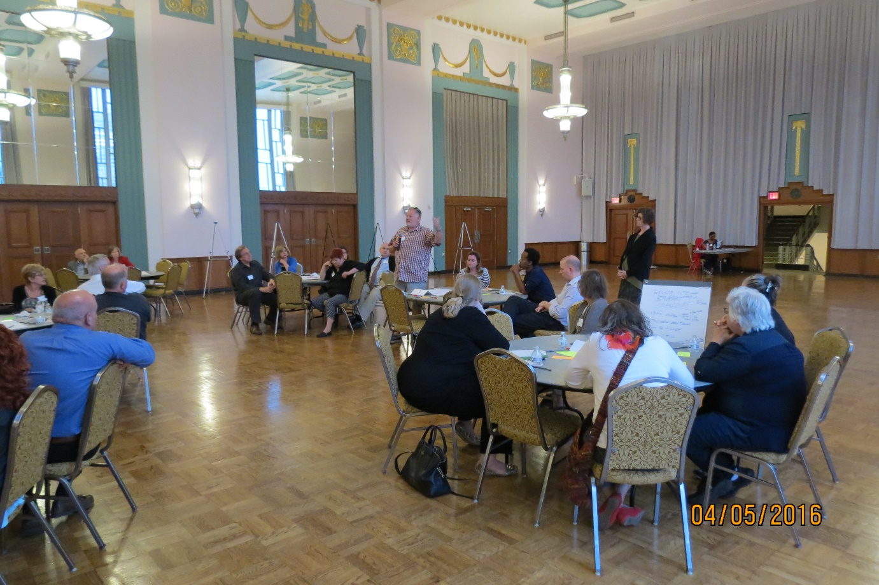
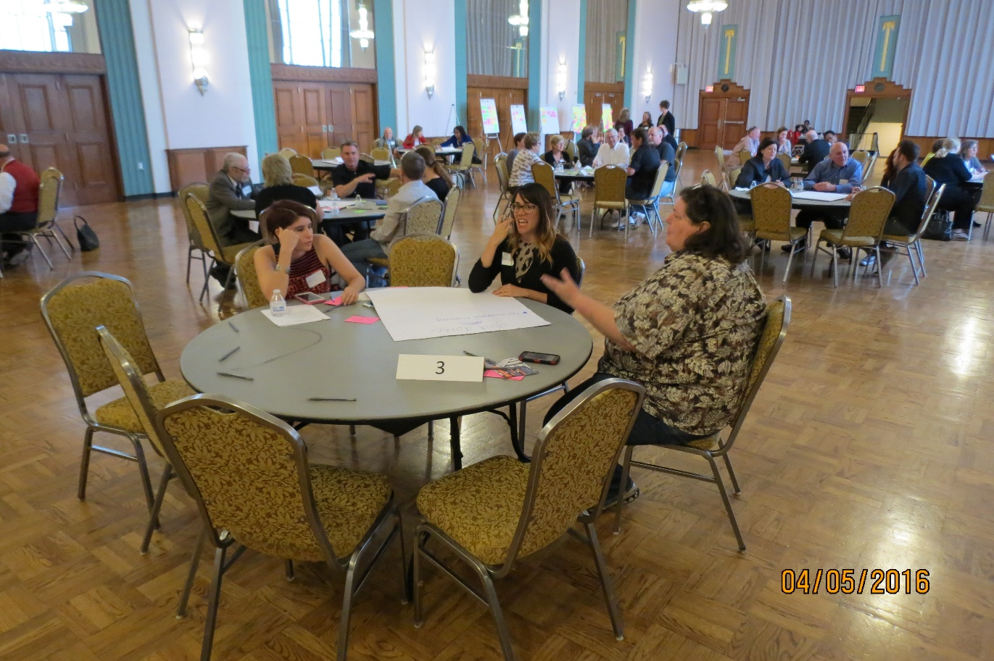
APA-OK’S OUTSTANDING PLAN 2023 PRESERVEOKC
Public Meetings
Notes:
The planning process for preserveokc began in 2015 with internal research and data collection and a public kick-off meeting. This was followed by the formation of a stakeholder committee comprised of representatives in the public, private, and non-profit sectors, all of whom have experience with and interest in historic preservation. Additional outreach efforts included meetings with small groups and individuals representing neighborhoods, commercial districts, design review committees, and professionals working in preservation, stakeholder workshops, and an online survey. Many survey efforts and studies completed recently as part of the development of planokc were also incorporated.

Slide 10
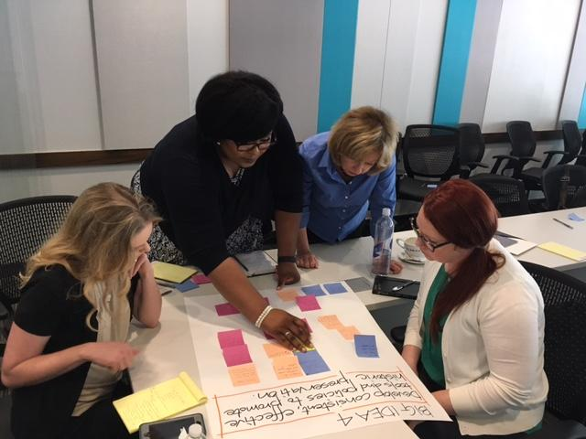
APA-OK’S OUTSTANDING PLAN 2023 PRESERVEOKC
Focus Group Workshop
Notes:
Throughout the planning process, staff delivered updates at public meetings with elected and appointed officials, including presentations to the Historic Preservation Commission, Planning Commission, and City Council and integrated comments into the plan draft. The resulting plan utilizes public and stakeholder input, resident surveys, data analysis, and best practices to inform the plan’s recommendations.
The draft plan was presented at a joint workshop of the Historic Preservation Commission, Planning commission and City Council in Fall 2019, followed by a 30 day public comment period. The plan was adopted and recommended to Planning Commission and City Council by Oklahoma City’s Historic Preservation Commission in January 2020, and was subsequently adopted by Planning Commission and received by City Council in April 2020 and July 2020, respectively.

Slide 11
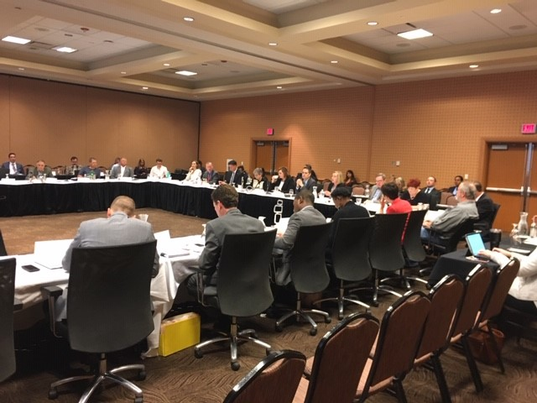
APA-OK’S OUTSTANDING PLAN
2023 PRESERVEOKC
APA-OK’S OUTSTANDING PUBLIC PROGRAM 2021 MIDTOWN’S WALKER AVENUE OKLAHOMA CITY
SCOOTING ON WALKER
Notes:
Preserveokc’s innovative approach to historic preservation as an integral component of the planning field, rather than an isolated set of tools to regulated specific buildings, advances the work of planning toward a comprehensive understanding of the social, cultural, economic, and environmental impact that the existing built environment has on our community.

Slide 12
AWARD CATEGORIES
Outstanding Plan
Outstanding Citizen Planner
Outstanding Student Project

Slide 13
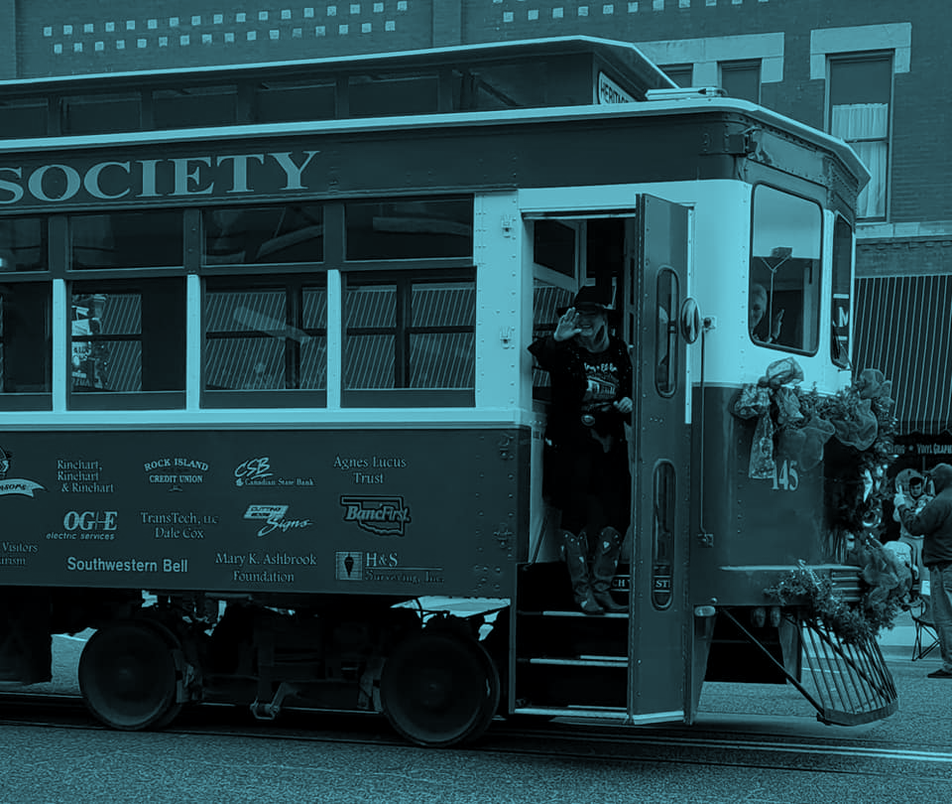
APA-OK’S OUTSTANDING CITIZEN PLANNER
2023 VICKI PROCTOR
Vicki Proctor
Notes:
Vicki Proctor has been an advocate for El Reno for decades. Vicki is an oral historian, always ready to hear, share, and promote the story of El Reno, Oklahoma.

Slide 14
APA-OK’S OUTSTANDING CITIZEN PLANNER 2023 VICKI PROCTOR
Hotel El Reno
Notes:
The long time President of the Canadian County Historical Museum has worked diligently to save and preserve El Reno’s history, from the artifacts in the museum to buildings like the historic El Reno Hotel and the Sheridan, the oldest building in Canadian County, and the former headquarters for Gen. Phillip Sheridan in the late 19th Century.
“All that history is right there at your fingertips,” Proctor said to the El Reno Tribune about the link between El Reno’s history, and the opportunity for cultural heritage tourism as a boost to the economy (Smith, Shane, “History Restored.” El Reno Tribune, 30 Nov. 2019).

Slide 15
APA-OK’S OUTSTANDING CITIZEN PLANNER 2023 VICKI PROCTOR
Heritage Express Trolley
Notes:
In 1993, the City of El Reno applied for Intermodal Surface Transportation Efficiency Act (ISTEA) funding for a project that would bring a trolley back to historic downtown. Proctor, working through the museum, championed the project and garnered support from citizens and other organizations, including El Reno Main Street. Vicki saw that the project was completed, done correctly, and facilitated upgrades to the museum building and grounds. Under Vicki’s leadership, the Canadian County Historical Museum purchased a trolley and had it refurbished so that there would be a trolley on the tracks provided in the ISTEA project, and has operated the trolley since its installation.

Slide 16
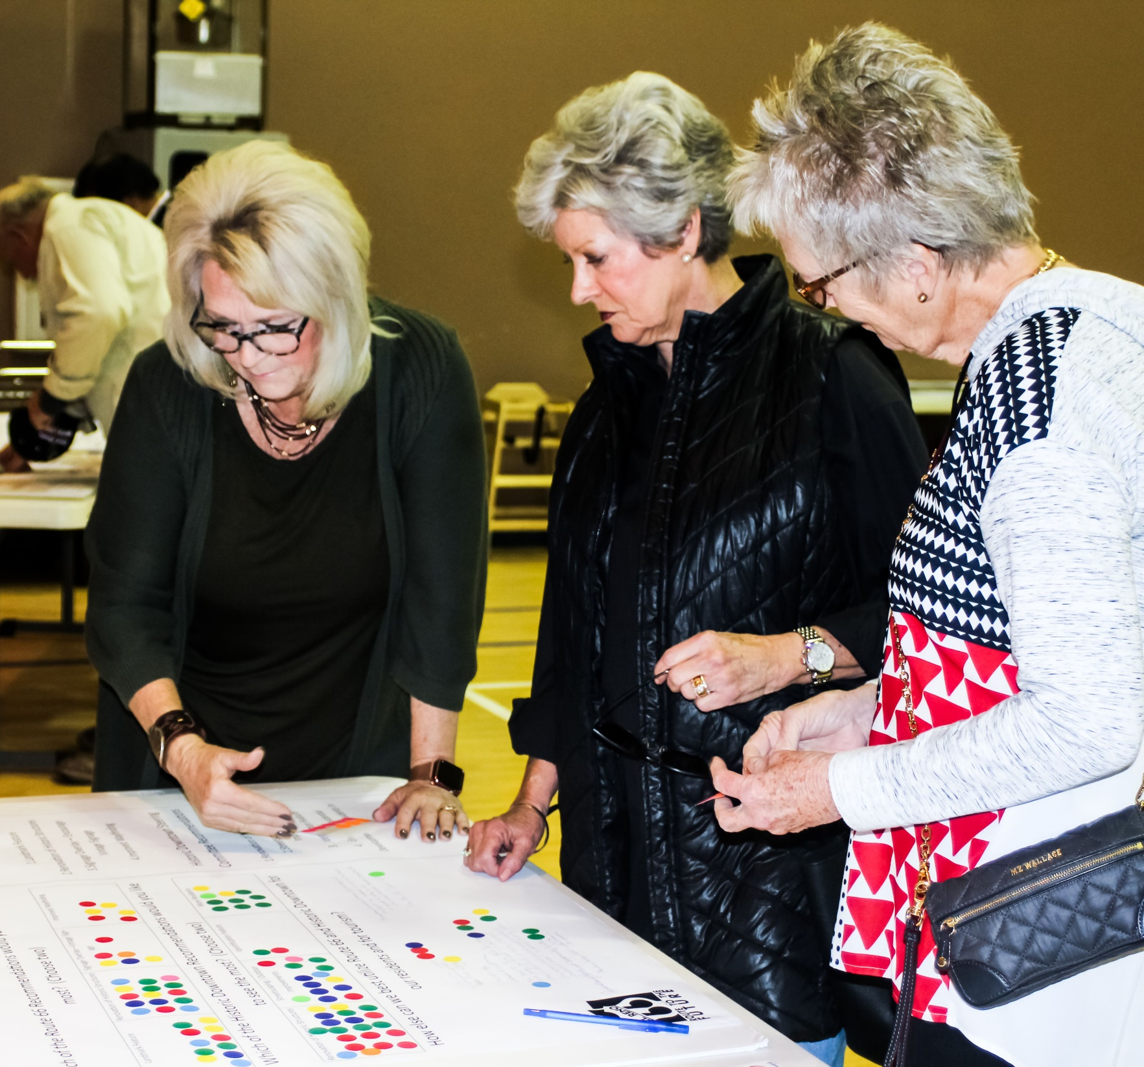
APA-OK’S OUTSTANDING CITIZEN PLANNER 2023 VICKI PROCTOR
Vicki helping gather community feedback at Route to the Future Open House
Notes:
Proctor joined the El Reno Municipal Planning Commission in February 2004, and was elevated to Vice Chair by August of that year. In her role, she has constantly been pro-growth, and more importantly, pro-responsible growth. In 2017, Proctor became Chair, and has led with enthusiasm and zeal to find the best possible answer for her community. In spring of 2018, the commissioners were discussing a potential new requirement that sidewalks be installed on commercial properties. Proctor’s contributions in that debate led El Reno to adopt a “fee-in-lieu” for sidewalks, which has helped the City construct sidewalk projects along many of our major corridors.
When discussing the creation of a new comprehensive plan, Proctor volunteered immediately, and then went to work recruiting others in the community to serve on the steering committee.

Slide 17
APA-OK’S OUTSTANDING CITIZEN PLANNER 2023 VICKI PROCTOR
Route to the Future community engagement at Burger Day
Notes:
Early in the planning process, Proctor offered to bring the trolley to El Reno’s Burger Day to draw people in. She coordinated logistics and ensured we would have a place to set up on the tracks. Vicki helped prepare for, execute, and encourage attendance for all of our open house events. Our engagement responses at every stage outpaced expectations.
Most recently, El Reno had the unique opportunity to do a corridor study project on Sunset Drive, a key commercial and residential corridor of Historic Route 66. Proctor opened up the museum to the consultant team, and assisted in researching with Emily Fitzsimmons to find relevant photos and history for the area. Her work in uncovering this history on this project advanced the cause of planning in El Reno, while providing new planners with experience, learning experiences, and new expertise.

Slide 18
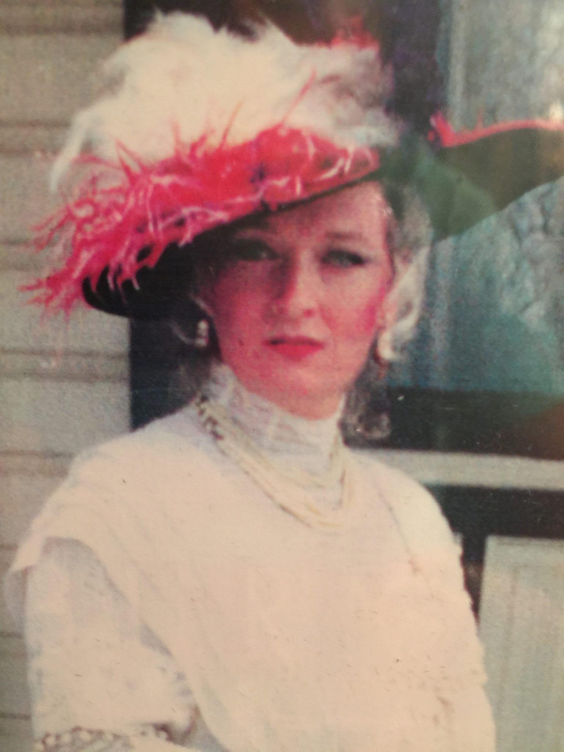
APA-OK’S OUTSTANDING CITIZEN PLANNER
2023 VICKI PROCTOR
Notes:
tombstone tales – Vicki Proctor in a historical re-enactment at the Canadian County Historical Museum
With gratitude for her hard work and dedication to the City of El Reno and all of Canadian County, both in the preservation of history, and in writing its next chapter, the City of El Reno staff would like to nominate Vicki Proctor for Outstanding Citizen Planner for the 2023 APA-Oklahoma Chapter Awards. Vicki’s selfless perseverance is unwavering, and has made a permanent impact on the community she loves, and has inspired passion and volunteerism in countless others. She is a model of the care, positivity, and intention needed to review individual items, and constantly envisions the best of all opportunities, and the best version of El Reno for all.

Slide 19
AWARD CATEGORIES
Outstanding Plan
Outstanding Citizen Planner
Outstanding Student Project

Slide 20
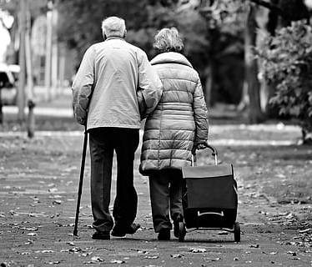
APA-OK’S OUTSTANDING STUDENT PROJECT 2023 LUKE KERR
APA-OK’S OUTSTANDING PUBLIC OUTREACH 2021 OKC 39TH STREET PUBLIC OUTREACH
“Who are We Planning With: Dementia-Friendly Planning in Oklahoma City”
Board members reimaging 39th Street
Notes:
Luke Kerr’s HONORS College Thesis, “Who Are We Planning With: a Look at Dementia-Friendly Planning in Oklahoma City.”
The demographics of the United States is undergoing a massive shift, as the number of older people, or people 65 years of age and over, will soon outnumber people aged 18 and under. Older populations experience higher rates of cognitive decline and thus face different challenges than the general population.

Slide 21
APA-OK’S OUTSTANDING STUDENT PROJECT 2023 DEMENTIA-FRIENDLY PLANNING IN OKLAHOMA CITY
Luke Kerr
Notes:
Dementia, a syndrome that causes changes in memory, orientation and judgement, and is often accompanied with changes in mood and behavior, affects the way in which millions of Americans experience space and place. While effort has been dedicated to understanding how people with dementia interact with interior spaces, there is an immense lack of research on how people with dementia interact with outdoor environments, including gardens, parks, streets, neighborhoods, and cities.
While city planners work to provide sustainable and accessible public spaces and services, there is a clear disconnect, and many barriers, between their efforts and the needs of aging communities.

Slide 22
APA-OK’S OUTSTANDING STUDENT PROJECT 2023 DEMENTIA-FRIENDLY PLANNING IN OKLAHOMA CITY
APA-OK’S OUTSTANDING PUBLIC OUTREACH 2021 OKC 39TH STREET PUBLIC OUTREACH
Board members reimaging 39th Street
Notes:
Through performing an extensive literature review and conducting semi-structured interviews, the author of this thesis examines how urban planners, accessibility professionals, and care partners in the Oklahoma City metro area define accessibility, understand accessibility planning practices, and suggest measures to be taken to improve conditions for aging individuals, especially those living with dementia.
Planners are more likely to define, understand, and implement accessibility in the context of physical mobility. Accessibility consultants and researchers are more likely to understand accessibility in a broader sense, calling for greater attention to the different types of disabilities and advocating for human-centered design processes. Care partners call for a broader social understanding and shift regarding accessibility and dementia, calling for education, financial support, and work across disciplines. Using the limited existing research on dementia-friendly planning and design, the project calls for better collaboration and education between care partners and those within the field of planning.

Slide 23
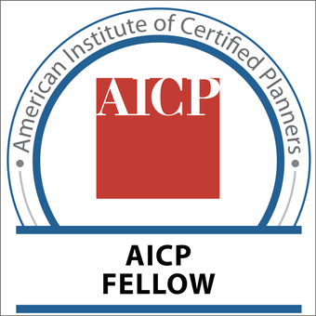
RECOGNITIONS
Notes:
Fellows of AICP are nominated and selected by their peers to recognize and honor their outstanding contributions as a professional planner. The outcomes of their individual efforts left demonstrably significant and transformational improvements to the field of planning and the communities they served. Fellows have achieved excellence in professional practice, teaching and mentoring, research, and community service and leadership.
Guidelines were recently updated to lower years of membership from 15 to 10.
We have over 40 people that meet the 10 year threshold
Especially want to talk with those of you in the crowd that have previous service to the state board or our national organization.
Just 2 still living in Oklahoma - Larry Hopper 2020

Slide 24
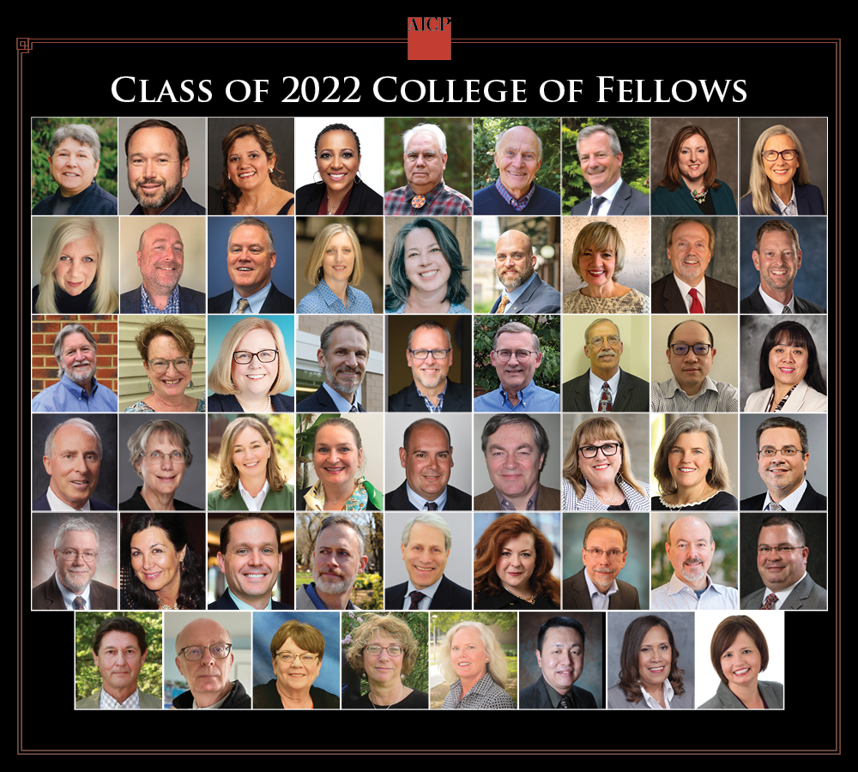
MICHAEL A. SOUTHARD, FAICP
APA-OK’S OUTSTANDING PUBLIC OUTREACH 2021 OKC 39TH STREET PUBLIC OUTREACH
Board members reimaging 39th Street
Executive Director of the Choctaw Nation of Oklahoma
Notes:
Michael has applied a civic entrepreneurial approach to address community problems for nearly 30 years. He is dedicated to empowering citizens and community leaders to visualize their desired future and employing planning principles to achieve it.
Michael’s leadership includes both his geographic and professional community at local, regional, state, and national levels. Michael’s entrepreneurialism has successfully addressing issues ignored or deemed too difficult to address by others. While focusing on small town America, he is also highly engaged and positioned in national-scale innovation. Peers nationwide seek advice and assessments. Michael is considered a trend-setter in cutting edge solutions and tangible results.

Slide 25
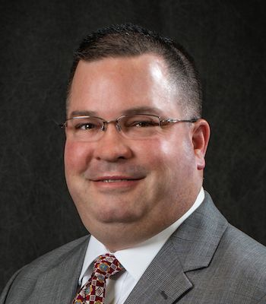
MICHAEL A. SOUTHARD, FAICP
APA-OK’S OUTSTANDING PUBLIC OUTREACH 2021 OKC 39TH STREET PUBLIC OUTREACH
Board members reimaging 39th Street
Executive Director of the Choctaw Nation of Oklahoma
Notes:
APA Involvement: Oklahoma Chapter, OKAPA President 2001-03, AICP Region 3 Commissioner 2004-08, STAR member.
How did you get involved in APA? I first became involved in the profession while in graduate school. I was elected as the student planning president in 1992 and served on the Oklahoma APA Board. Over the next 16 years, I served in ever chapter position and became the first and only Oklahoma planner to be elected to a national planning position.
What’s the most interesting project you’re working on? Two projects that I am currently working on include the creation of a rural business credit program using federal funding from the US Treasury through the State Small Business Credit Initiative. The second is a project where I am coordinating the evaluations of 8 industrial sites within the reservation. The Oklahoma Department of Commerce used ARPA funds to create a grant program where rural communities will receive up to $24K to hire a site consultant to assess their industrial site and recommend changes which will improve the site readiness. Eight of my community partners received funding, so my office is working with local leaders to move the process along.
What is one of your biggest successes? As the community development director, I was called upon to redevelop the business district of Shawnee, OK. We set a course which saw Shawnee pass one of the first “Existing Structures Codes” leading to over $100M in investments. My office also led the effort to create a downtown streetscape plan, downtown economic development strategy, and the downtown Tax Increment Financing District. I also wrote a TEA-21 grant to construct phase 1 of the streetscape project. Downtown Shawnee has seen tremendous improvement and now how loft residential apartments in the high-rise structures. Little to no investment had been made in 30 years prior to my actions.
Advice for planners just starting out? Be honest in your professional opinions. Know your role in the process as the planner (educator, facilitator, convener, advocate, etc.) and know the role of the elected officials (governing body). Many planners burn out and get frustrated because they don’t fully understand the distinction.
What’s the best part of working in small towns & rural areas? The best part is in seeing how your influence makes a difference. In larger communities or regions, one may never fully see the impact their actions have. Small and rural areas can have immediate fulfillment.

